Slide 1

SonarQube
Setting up Python Project Jenkins & SonarQube
Presented By :
Amrit Choudhary

Slide 2
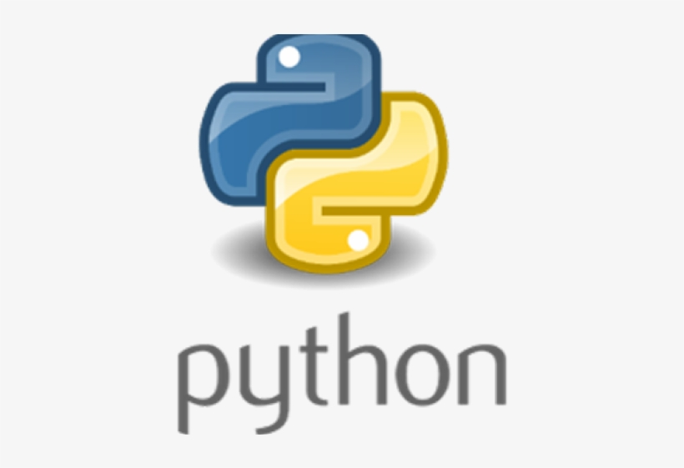
On boarding Python projects
Pre- Requisites
Python 3.7 installed on your master or remote node
Wherever you want to execute the python code

Slide 3
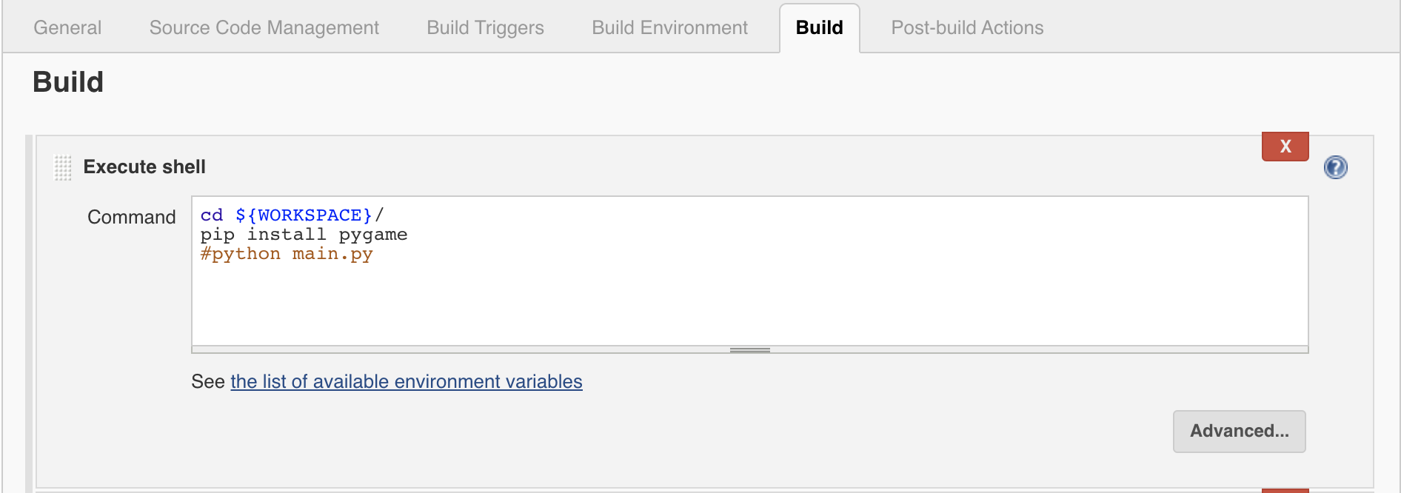
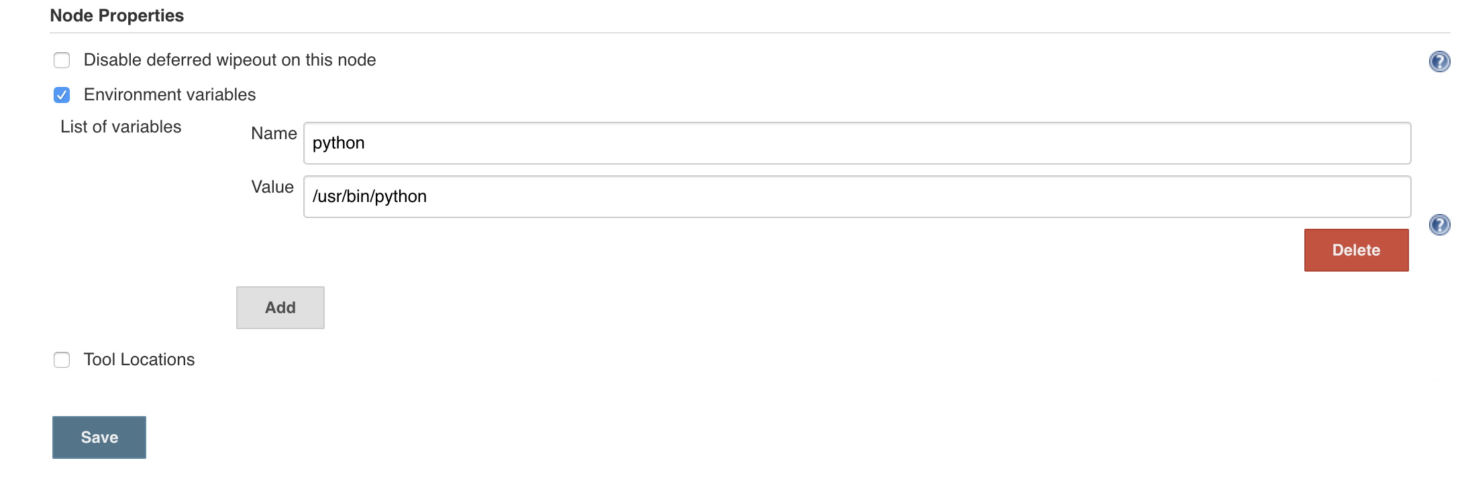
On boarding Python project on Jenkins
Follow the Video & Snapshots for reference
Above node properties changes if required in agent configuration

Slide 4
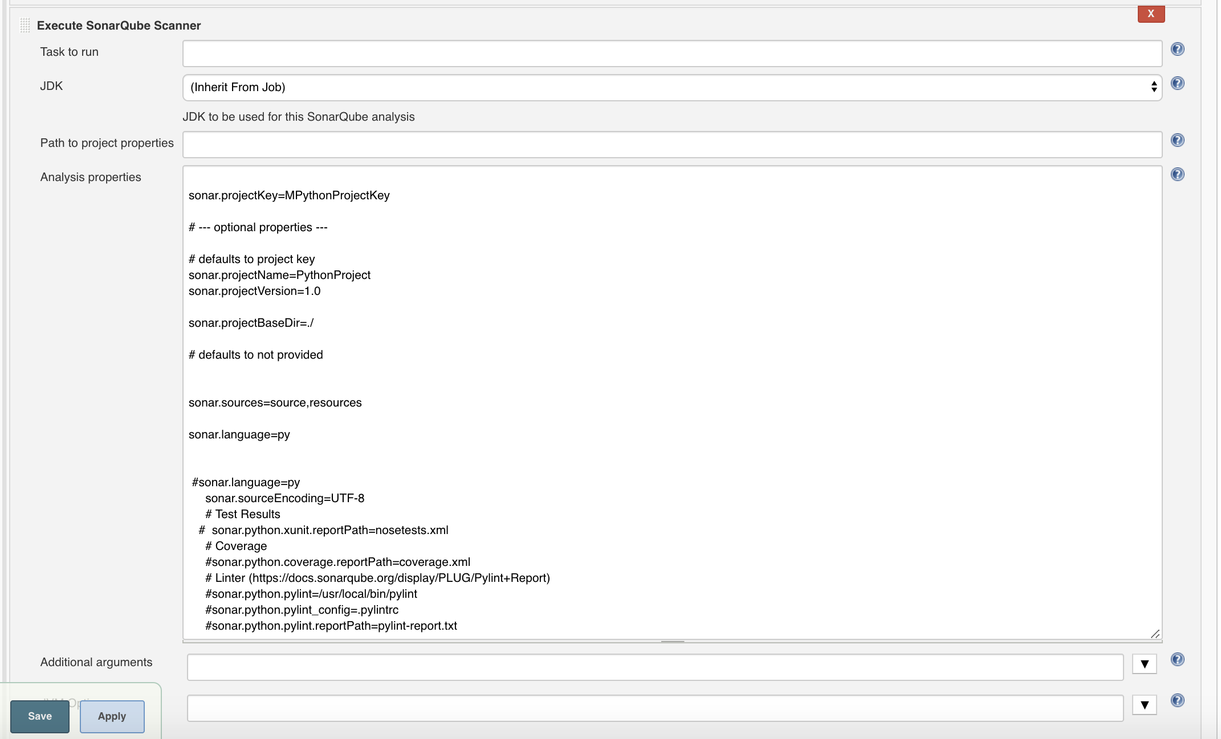
On boarding Python project on Jenkins Sonar Scanner

Slide 5
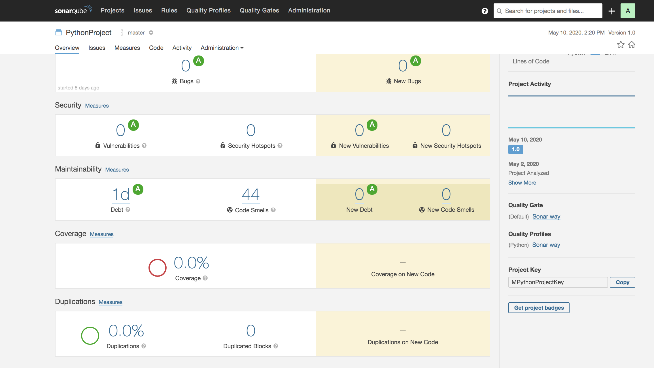
Run Jenkins Python Job : Final Result SonarQube

Slide 6
Congrats !!!
Python Project is on boarded successfully.
Git repo for Python : https://github.com/marblexu/PythonSuperMario.git

